Slide 1
Listening and integrated skills A2
Instructor: Nguyen Ha Phuong

Slide 2
Unit 6: Housing for the future
Pages 101-120

Slide 3
Lesson objectives
By the end of the lesson, students will be able to:
consider current and future housing challenges faced by both individuals and cities.
respond to a listening and a video about different options for living spaces.
describe the process of getting a new city built.
use adjective suffixes.
use context clues.
use diagrams and flowcharts to take notes.

Slide 4
TABLE OF CONTENTS
01
02
03
04
05
VOCABULARY A
LISTENING A
VIDEO WATCHING
VOCABULARY B
LISTENING B

Slide 5
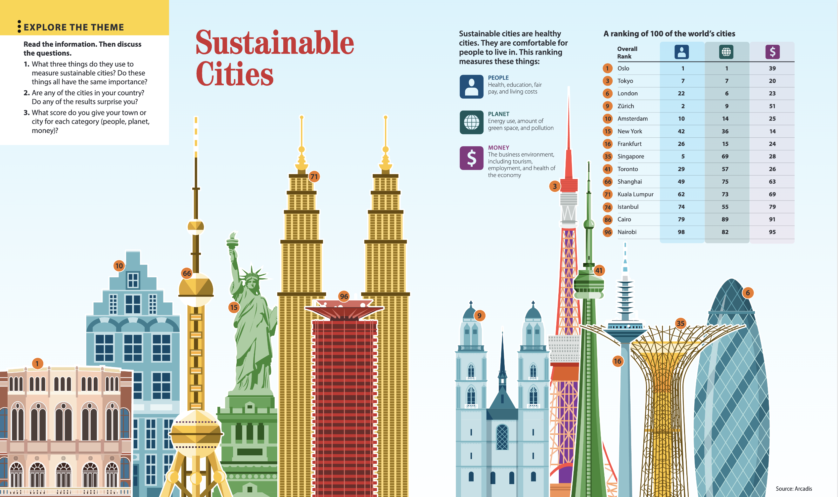

Slide 6

01
Vocabulary A

Slide 7

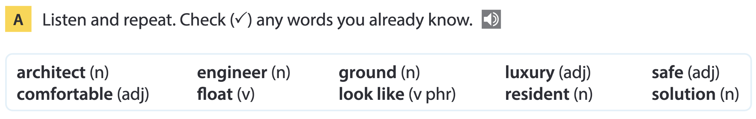
Page 104

Slide 8
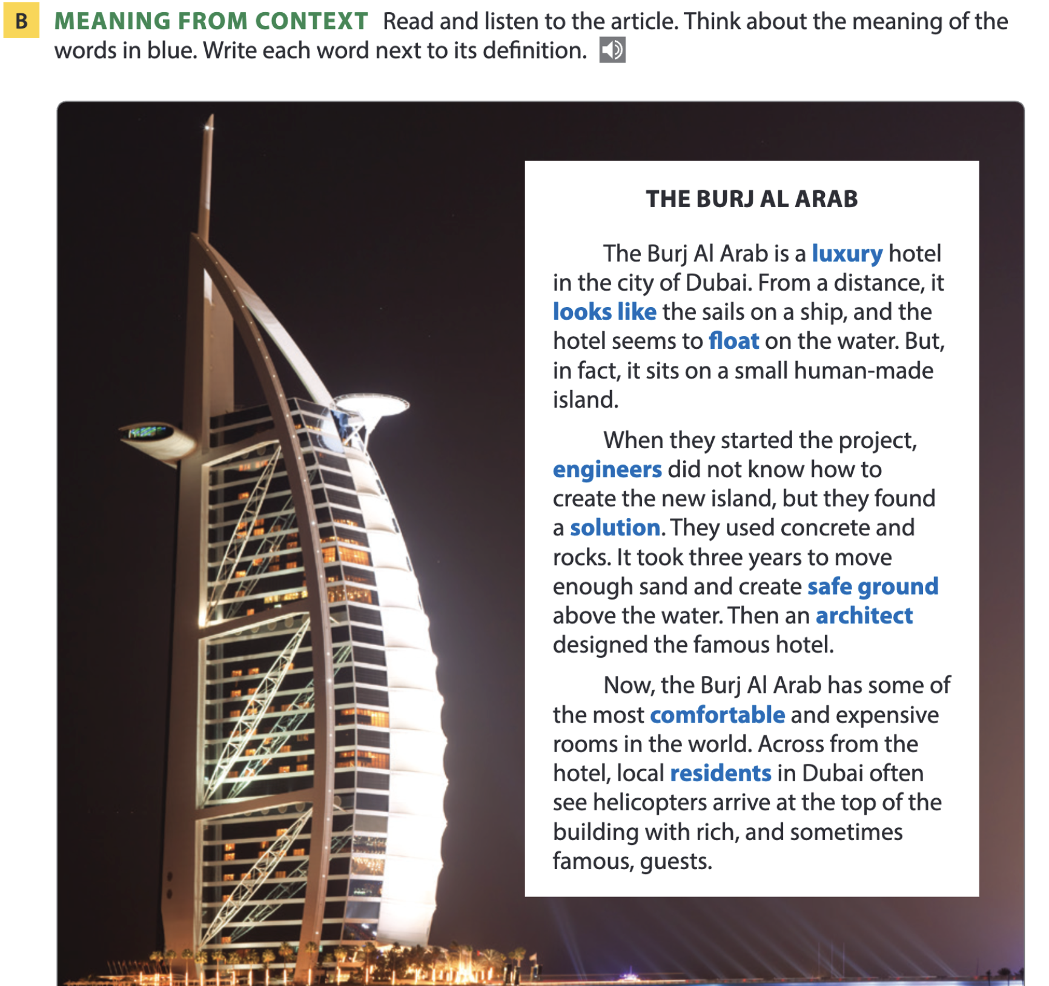
Page 104

Slide 9
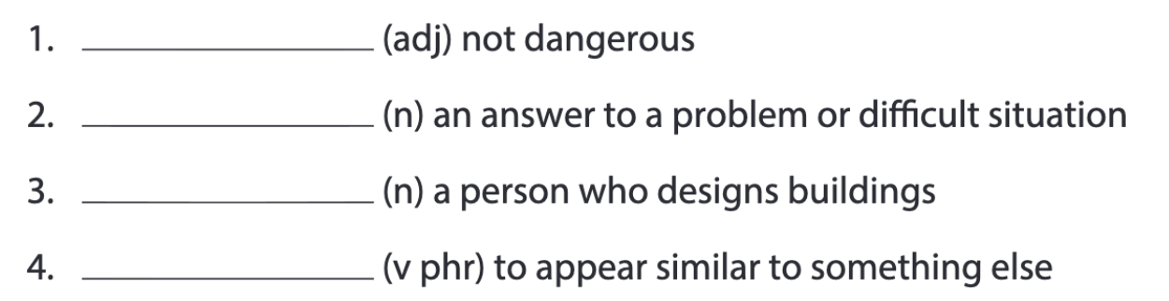
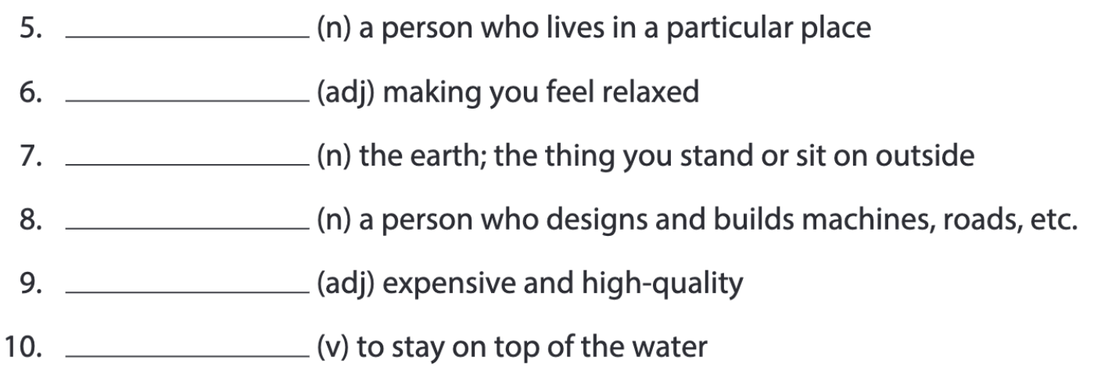
Pages 104-105
safe
solution
architect
look like
resident
comfortable
ground
engineer
luxury
float

Slide 10
Word list
safe /seɪf/ (adj): an toàn
solution /səˈluːʃən/ (n): giải pháp
architect /ˈɑːkɪtekt/ (n): kiến trúc sư
look like /lʊk laɪk/ (phr. v): trông giống
resident /ˈrezɪdənt/ (n): cư dân
comfortable /ˈkʌmftəbl/ (adj): thoải mái
ground /ɡraʊnd/ (n): mặt đất
engineer /ˌendʒɪˈnɪə(r)/ (n): kỹ sư
luxury /ˈlʌkʃəri/ (adj): sang trọng
float /fləʊt/ (v): nổi (trên mặt nước)

Slide 11
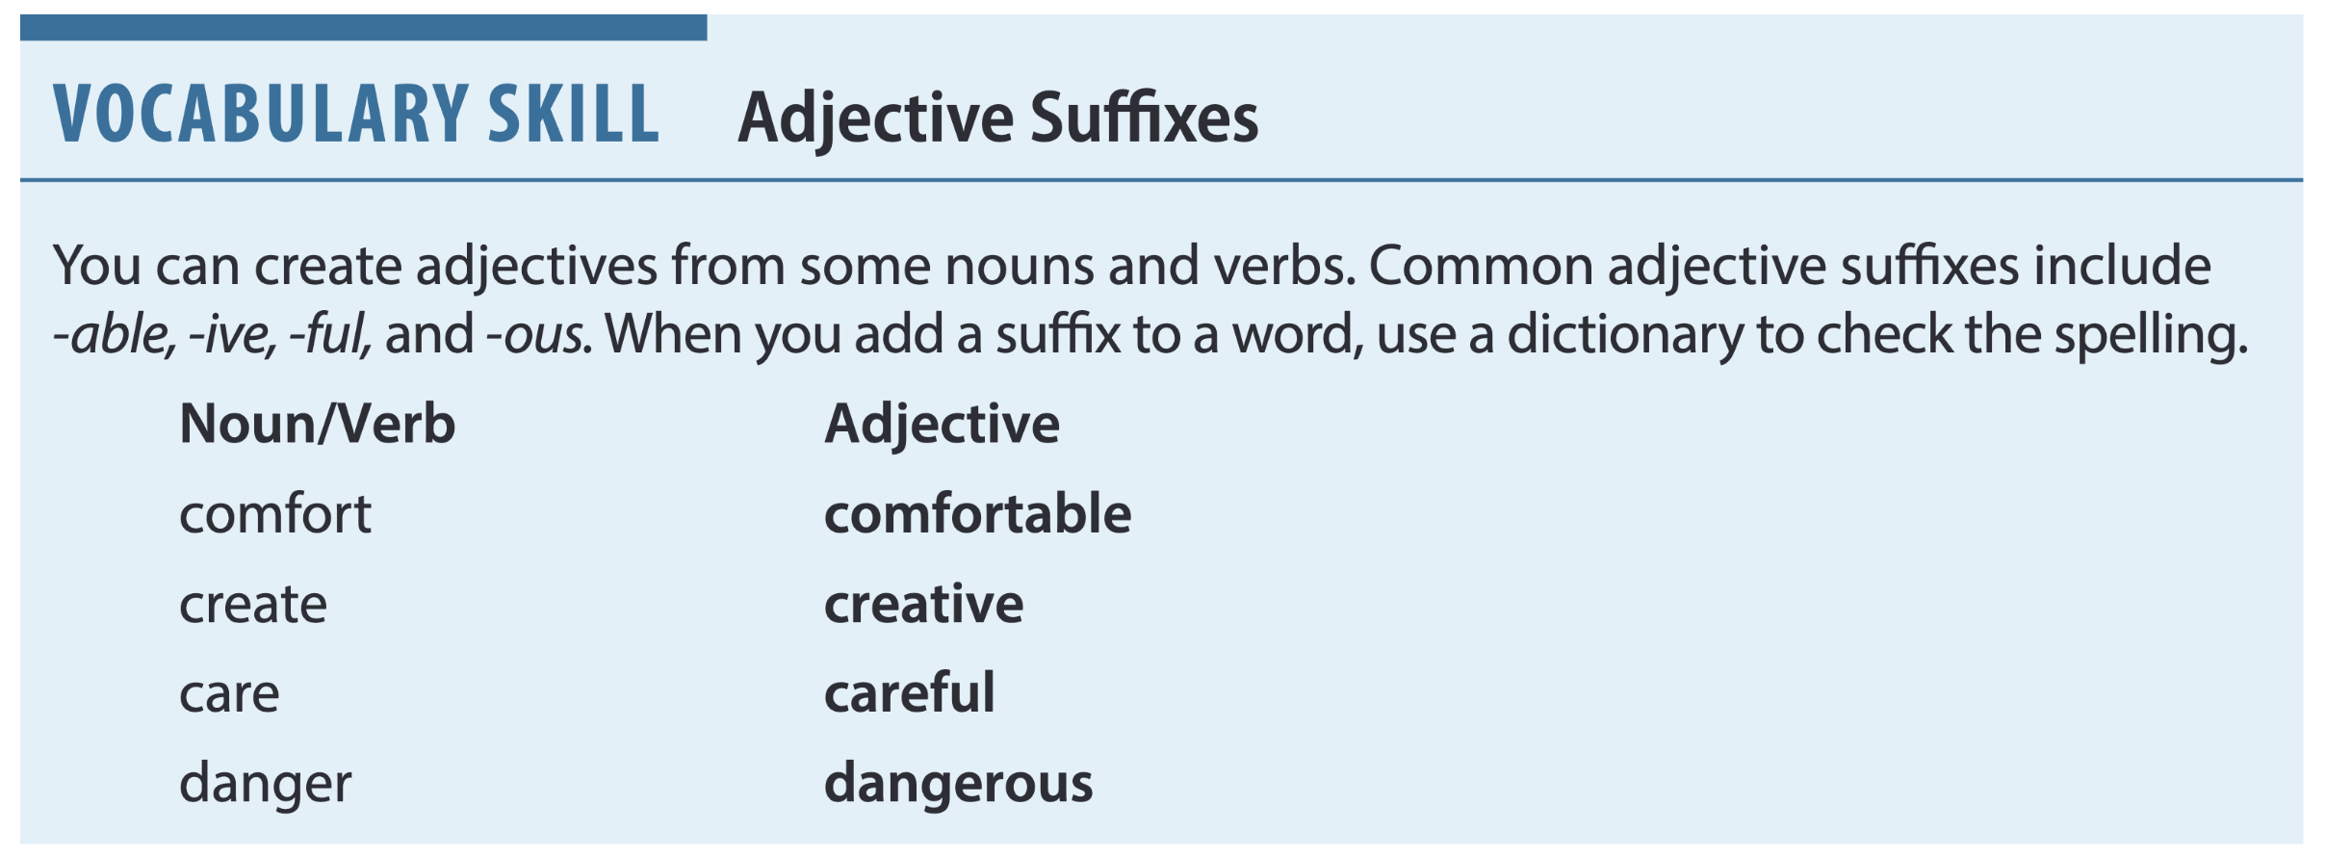
Page 105
Practice: Name any other adjectives with these suffixes.

Slide 12
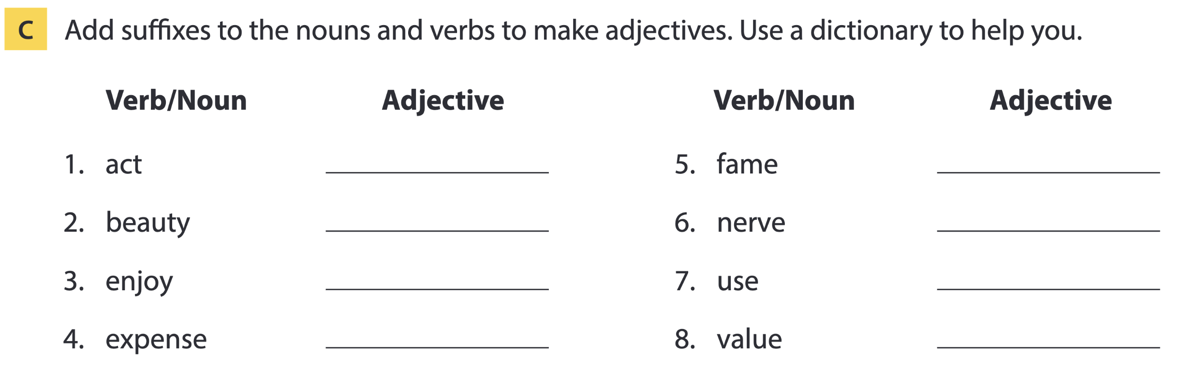
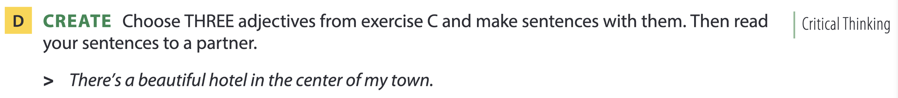
Page 105
active
beautiful
enjoyable
expensive
famous
nervous
useful/usable
valuable

Slide 13
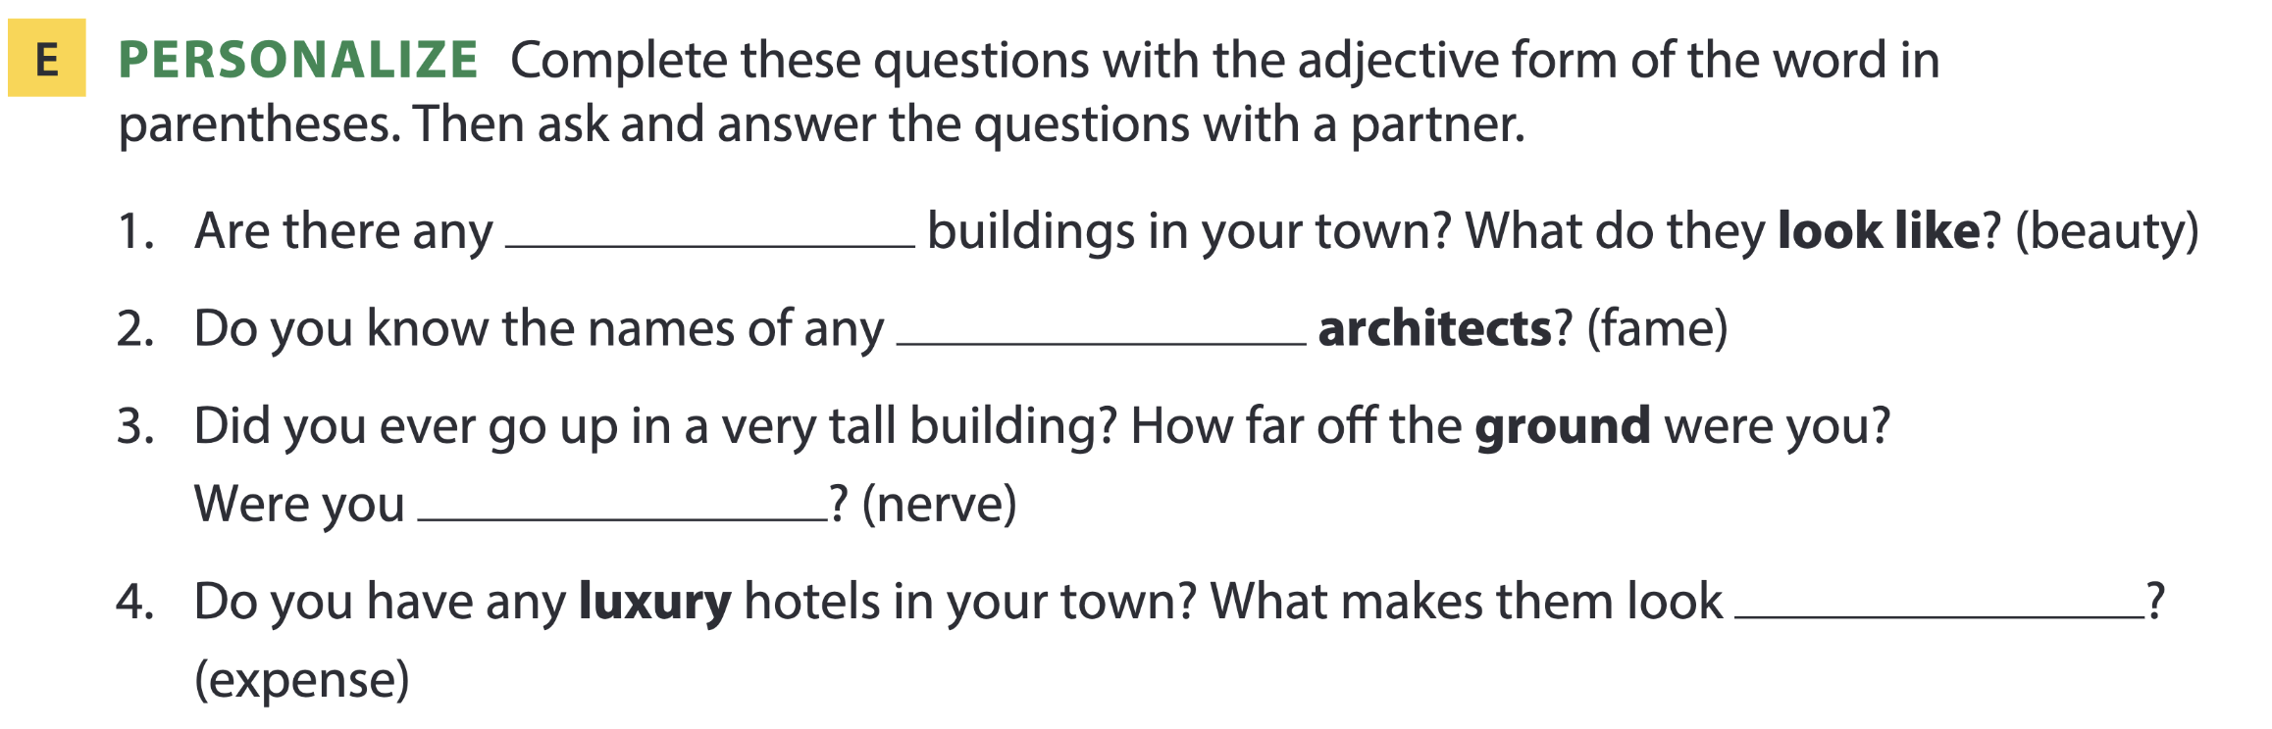
Page 105
beautiful
famous
nervous
expensive

Slide 14

02
Listening A

Slide 15
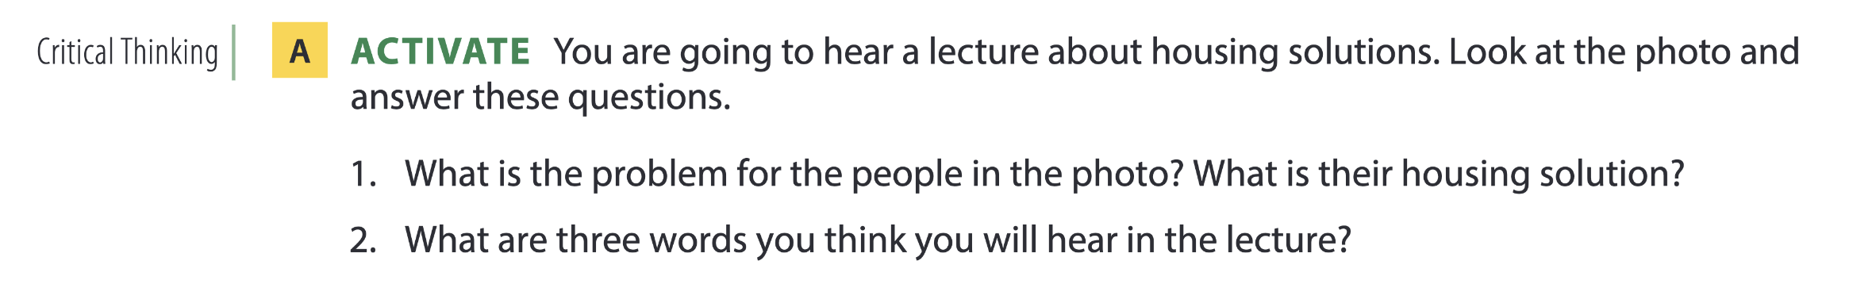
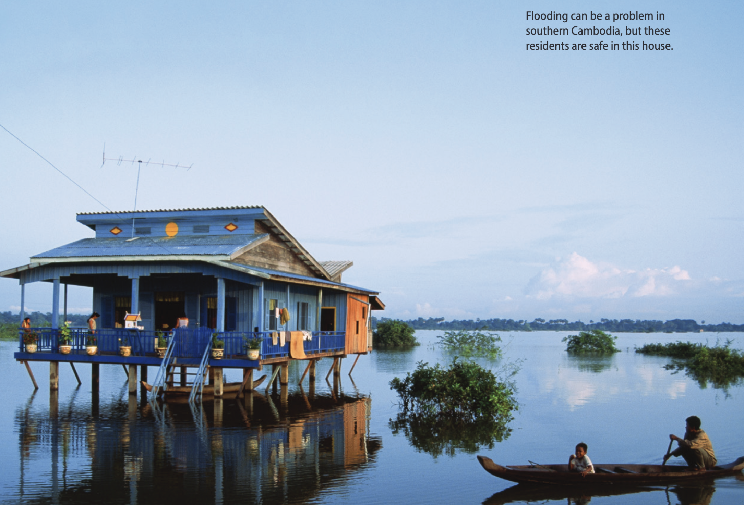
Housing solutions

Slide 16
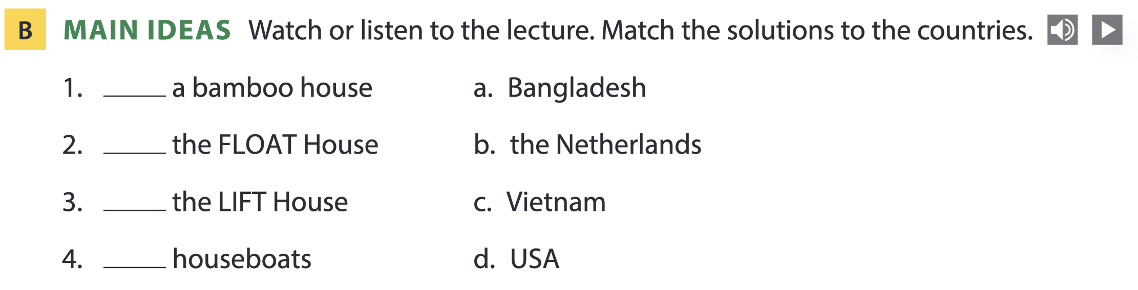
Page 106
c
d
a
b

Slide 17
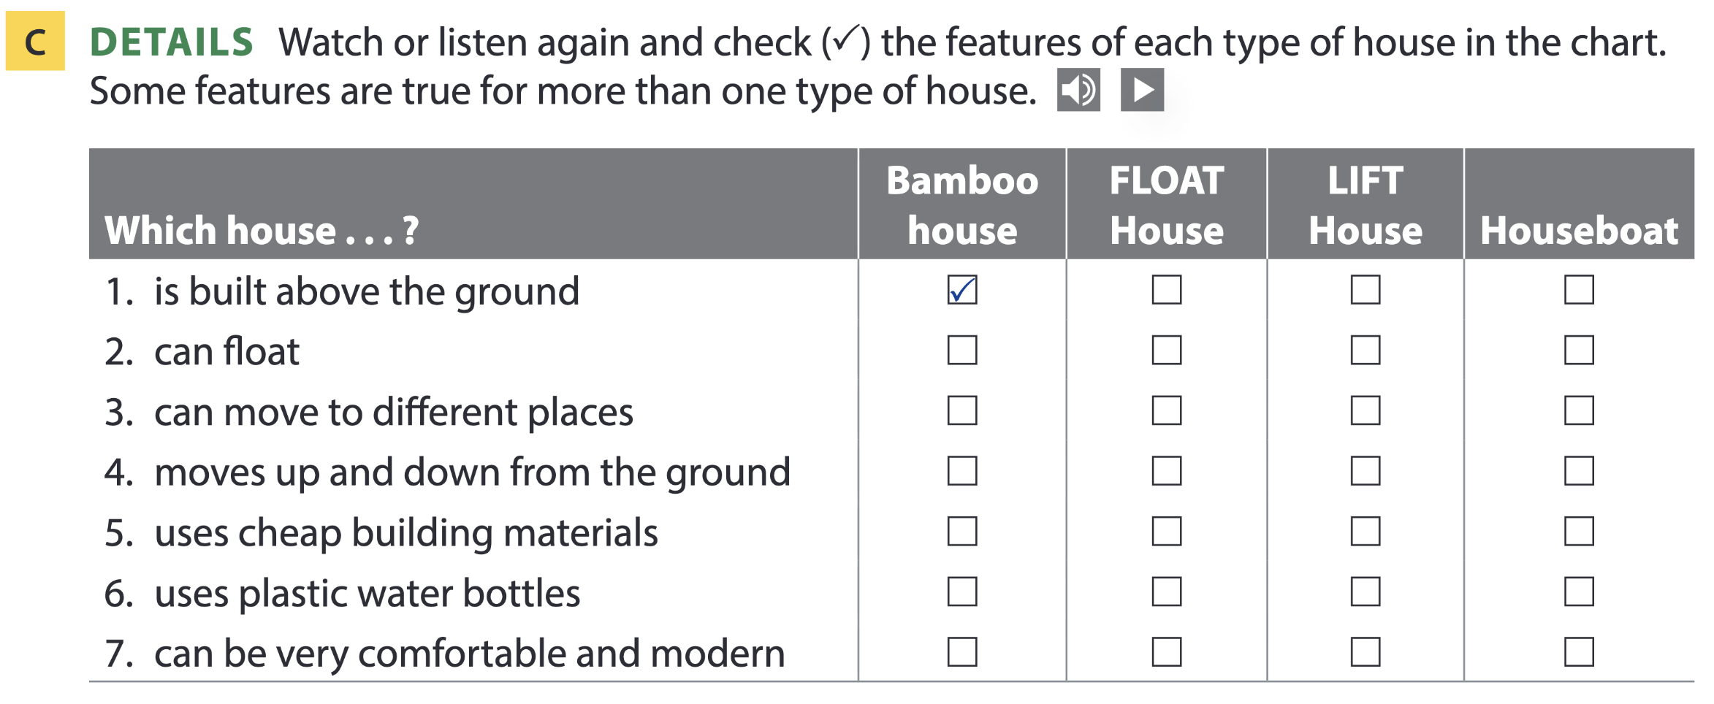

Page 107

Slide 18
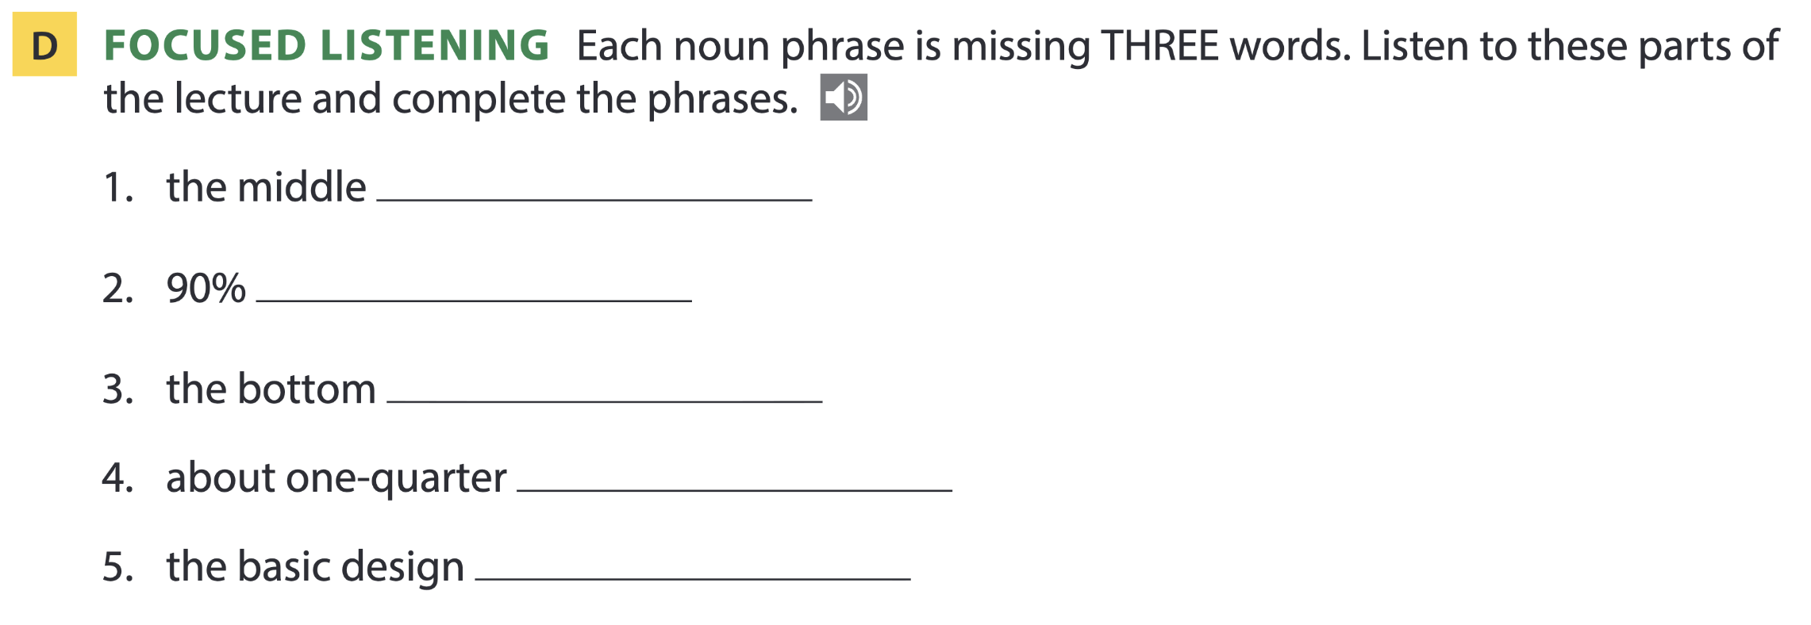
Page 107
of the country
Note: Two of the three words in each phrase are very small words that aren’t stressed as much as the other word.
of the residents
of the house
of the country
of a houseboat

Slide 19
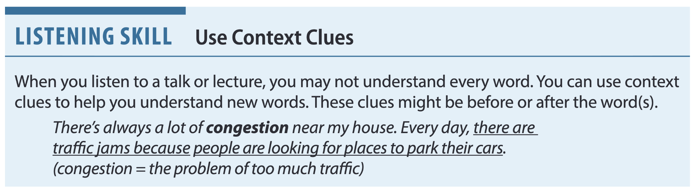
Page 107

Slide 20
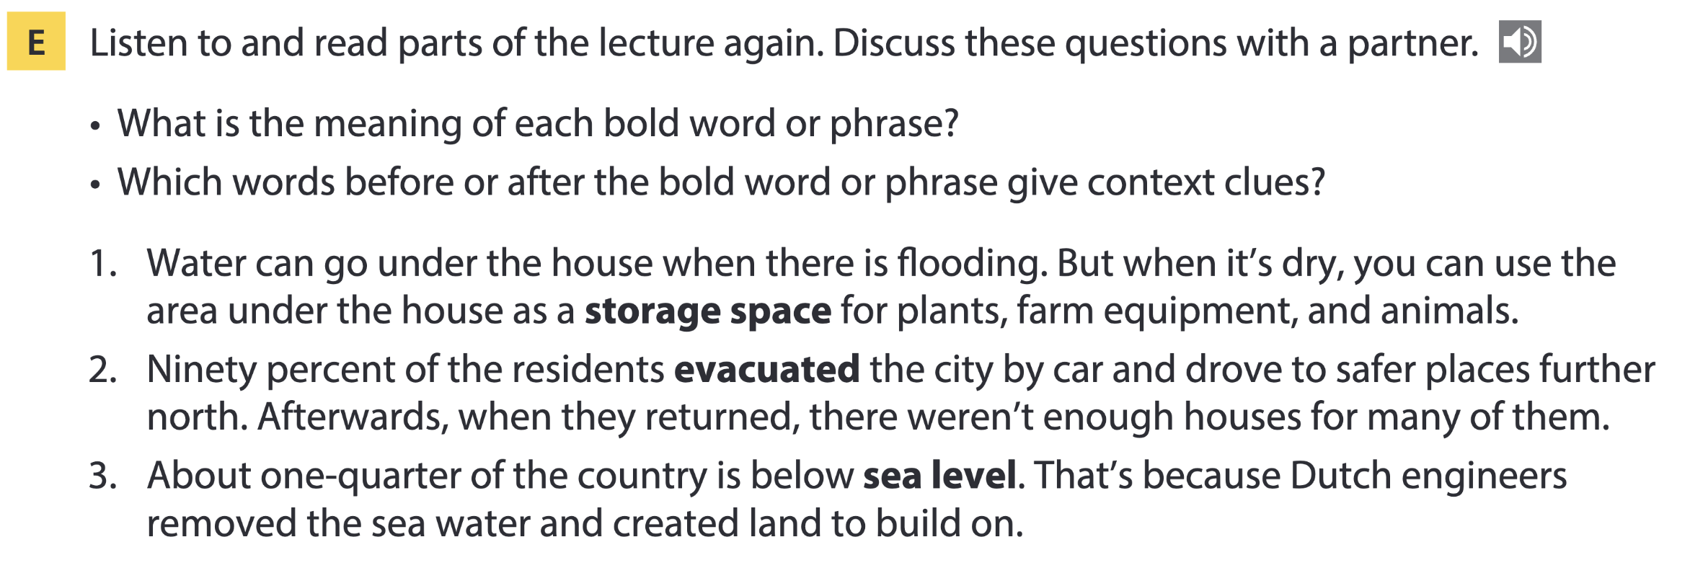
Page 107

Slide 21
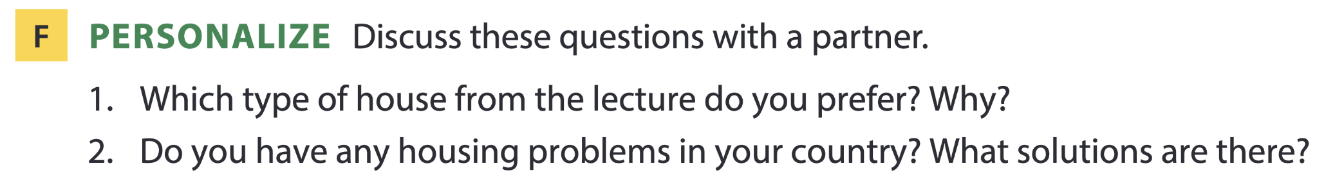

Page 107

Slide 22

03
Video watching

Slide 23
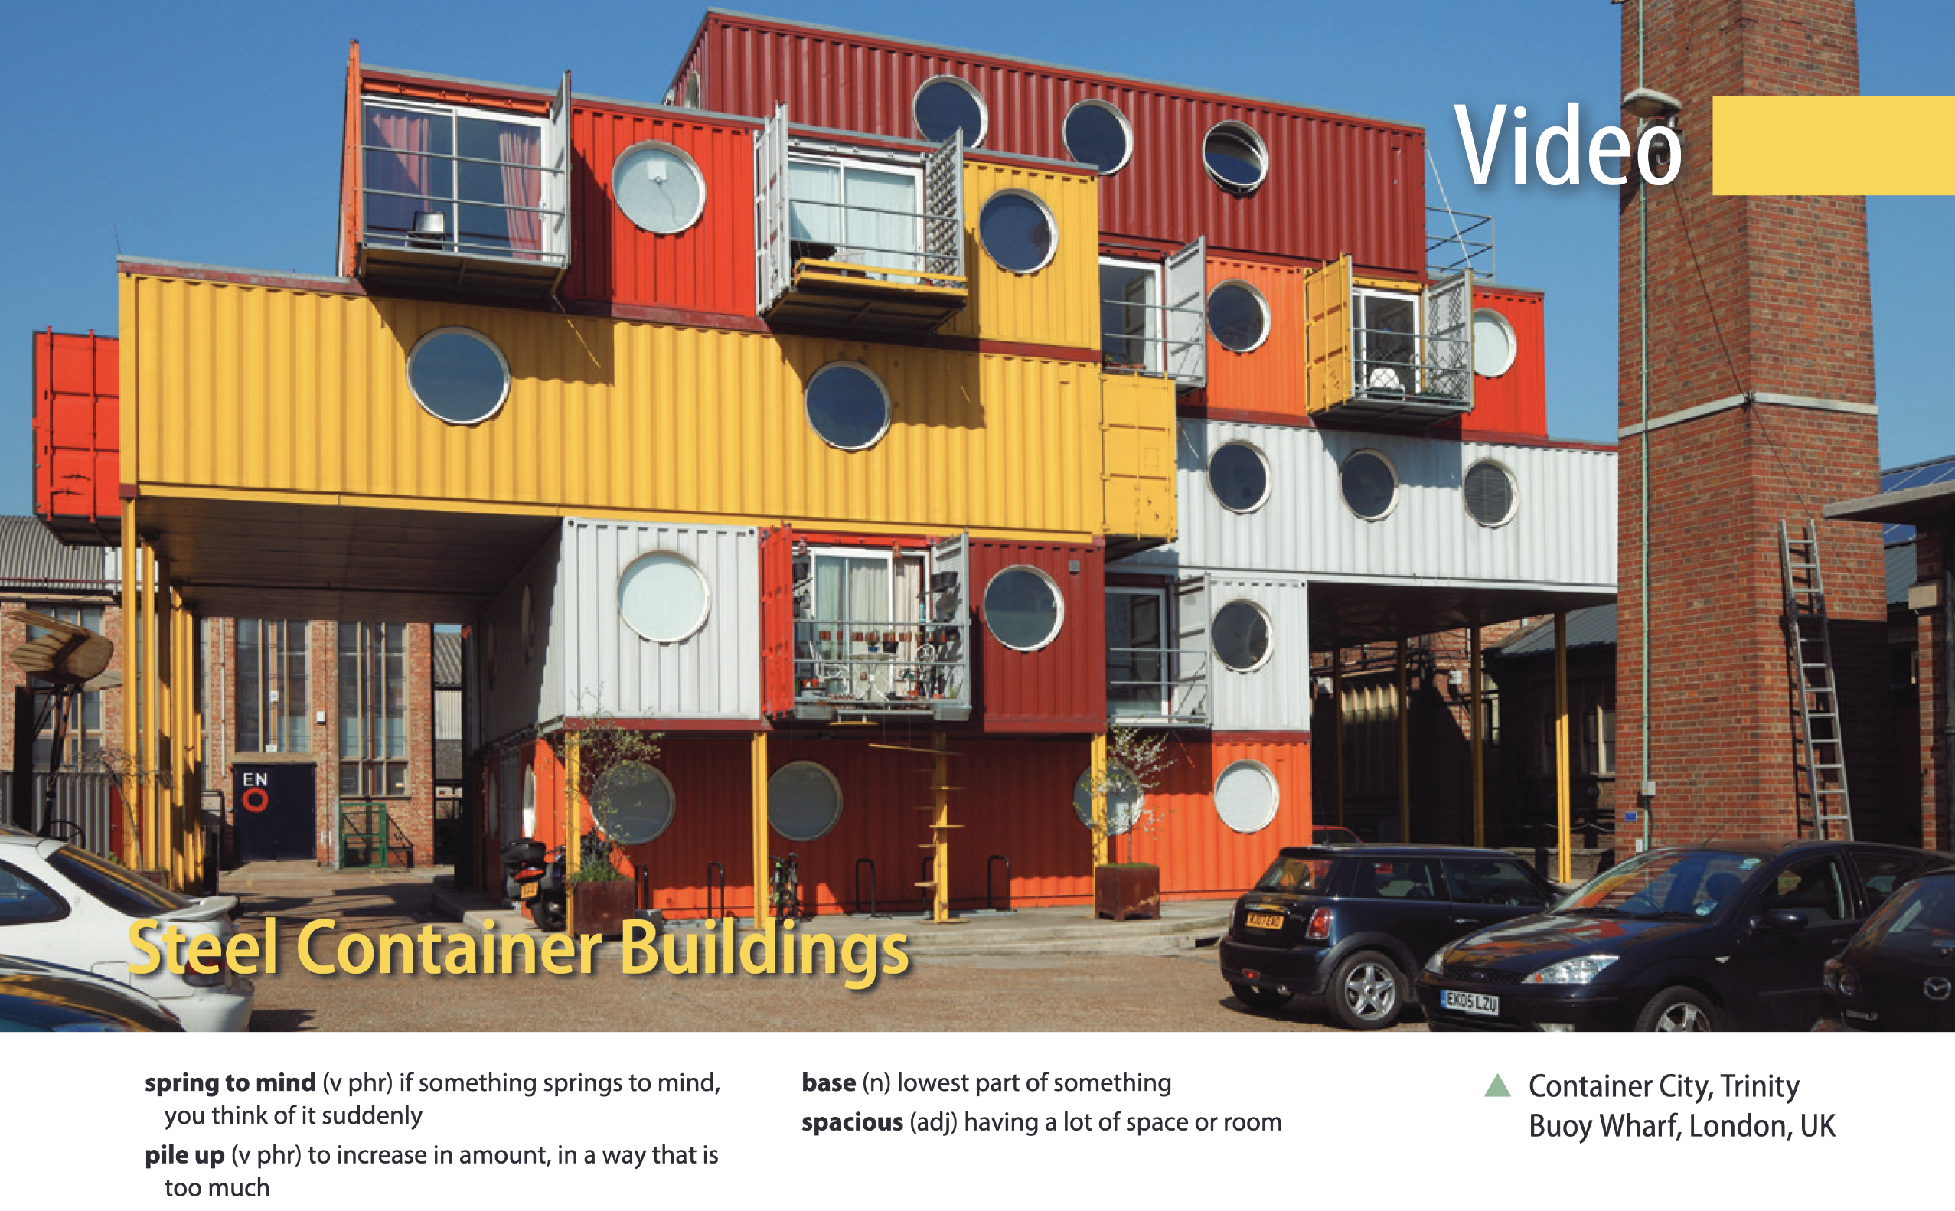
Page 111

Slide 24
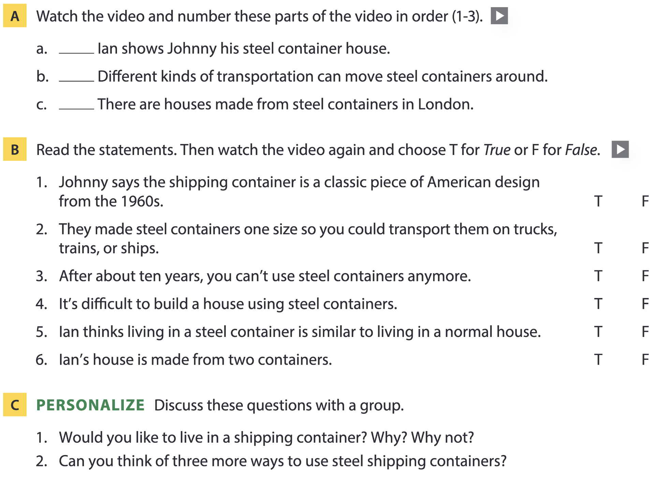
Page 111
3
1
2

Slide 25
04
Vocabulary B

Slide 26
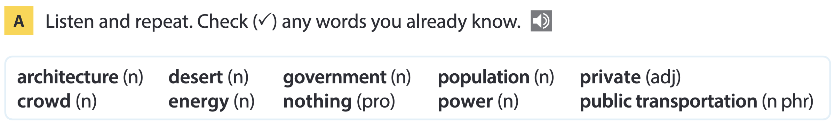
Page 112

Slide 27
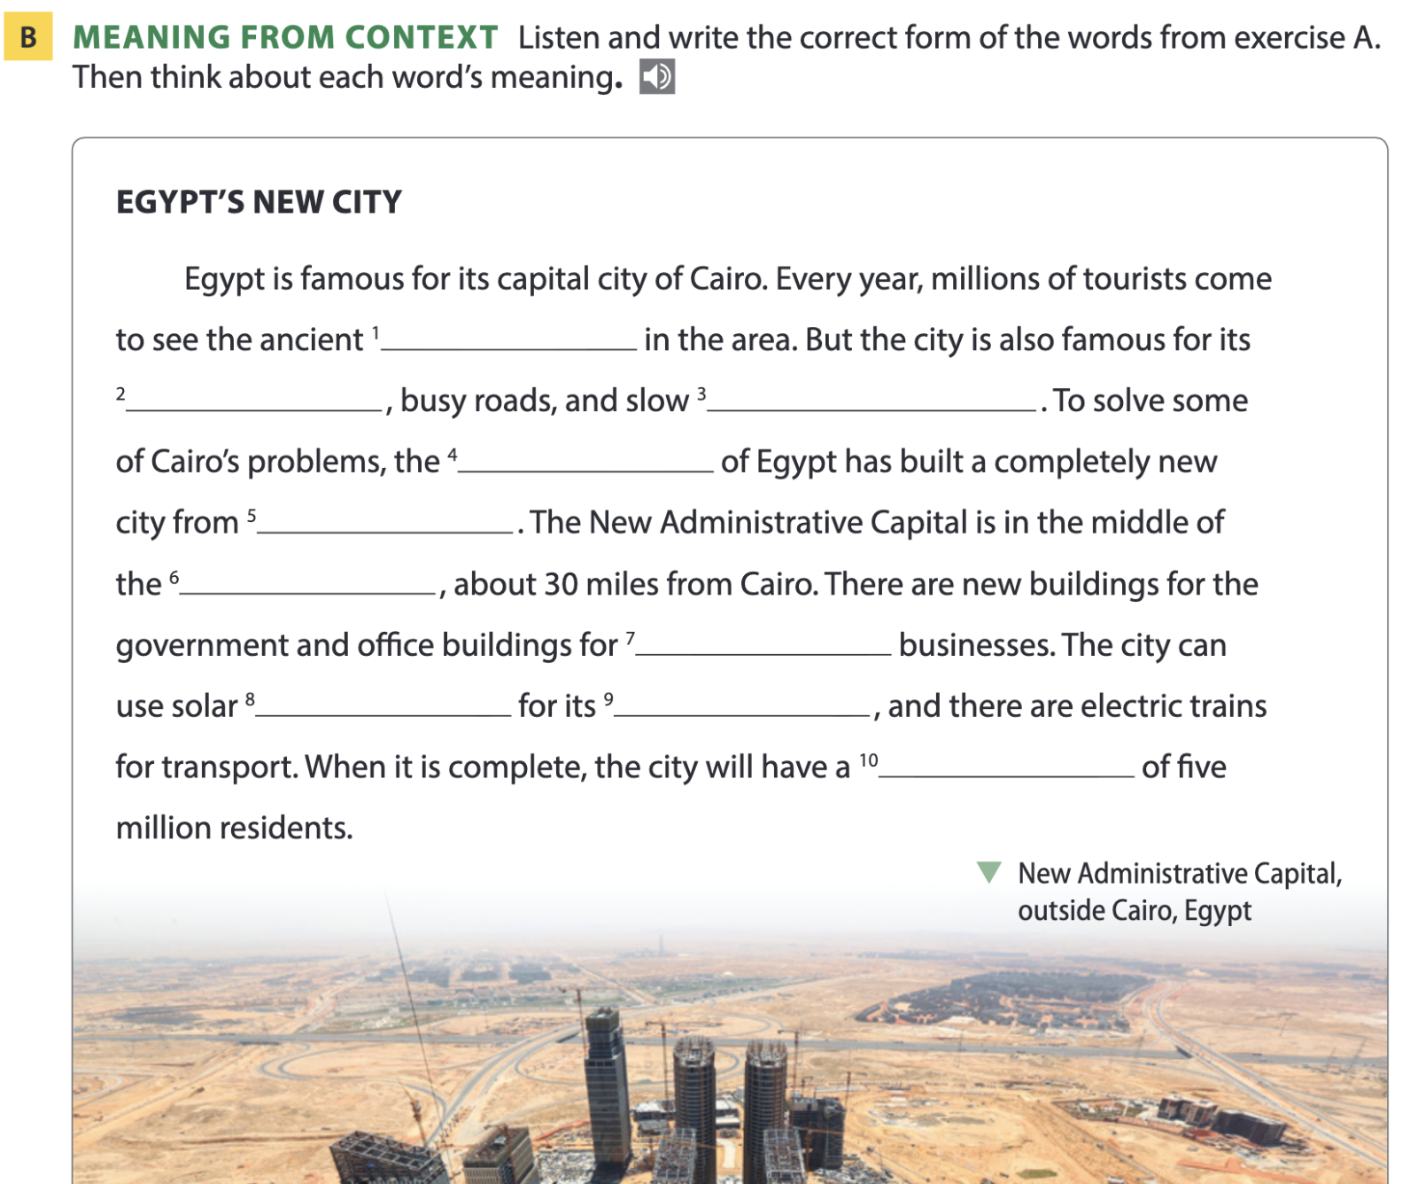
Page 112
architecture
crowds
public transportation
government
nothing
desert
private
energy
power
population

Slide 28
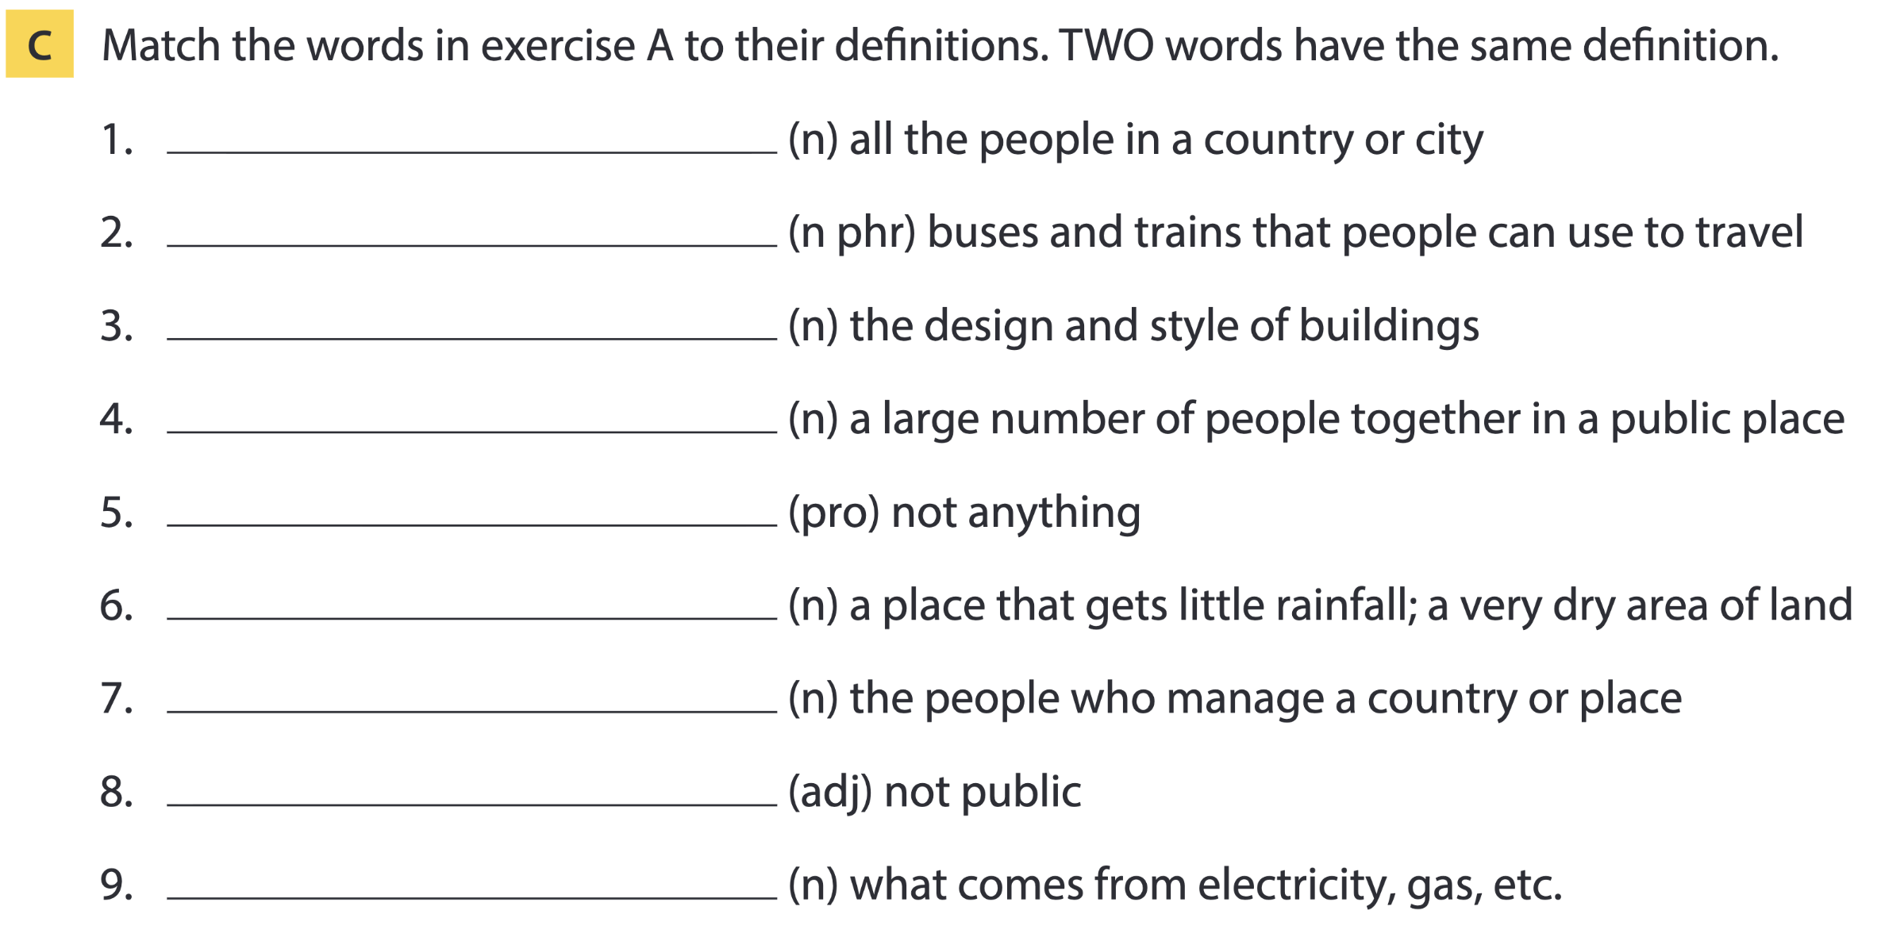
Page 113
population
public transportation
architecture
crowd
nothing
desert
government
private
energy; power

Slide 29
Word list
population /ˌpɒpjʊˈleɪʃən/ (n): dân số
public transportation /ˌpʌblɪk ˌtrænspɔːˈteɪʃən/ (n phr): phương tiện giao thông công cộng
architecture /ˈɑːkɪtektʃə(r)/ (n): kiến trúc
crowd /kraʊd/ (n): đám đông
nothing /ˈnʌθɪŋ/ (pro): không gì cả
desert /ˈdezət/ (n): sa mạc
government /ˈɡʌvənmənt/ (n): chính phủ
private /ˈpraɪvət/ (adj): riêng tư
energy /ˈenədʒi/; power /ˈpaʊə(r)/ (n): năng lượng

Slide 30
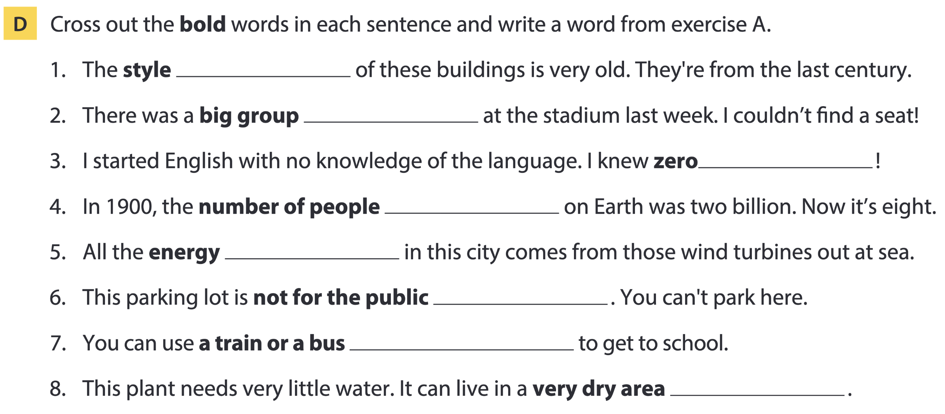
Page 113
architecture
crowd
nothing
population
power
private
public transportation
desert

Slide 31
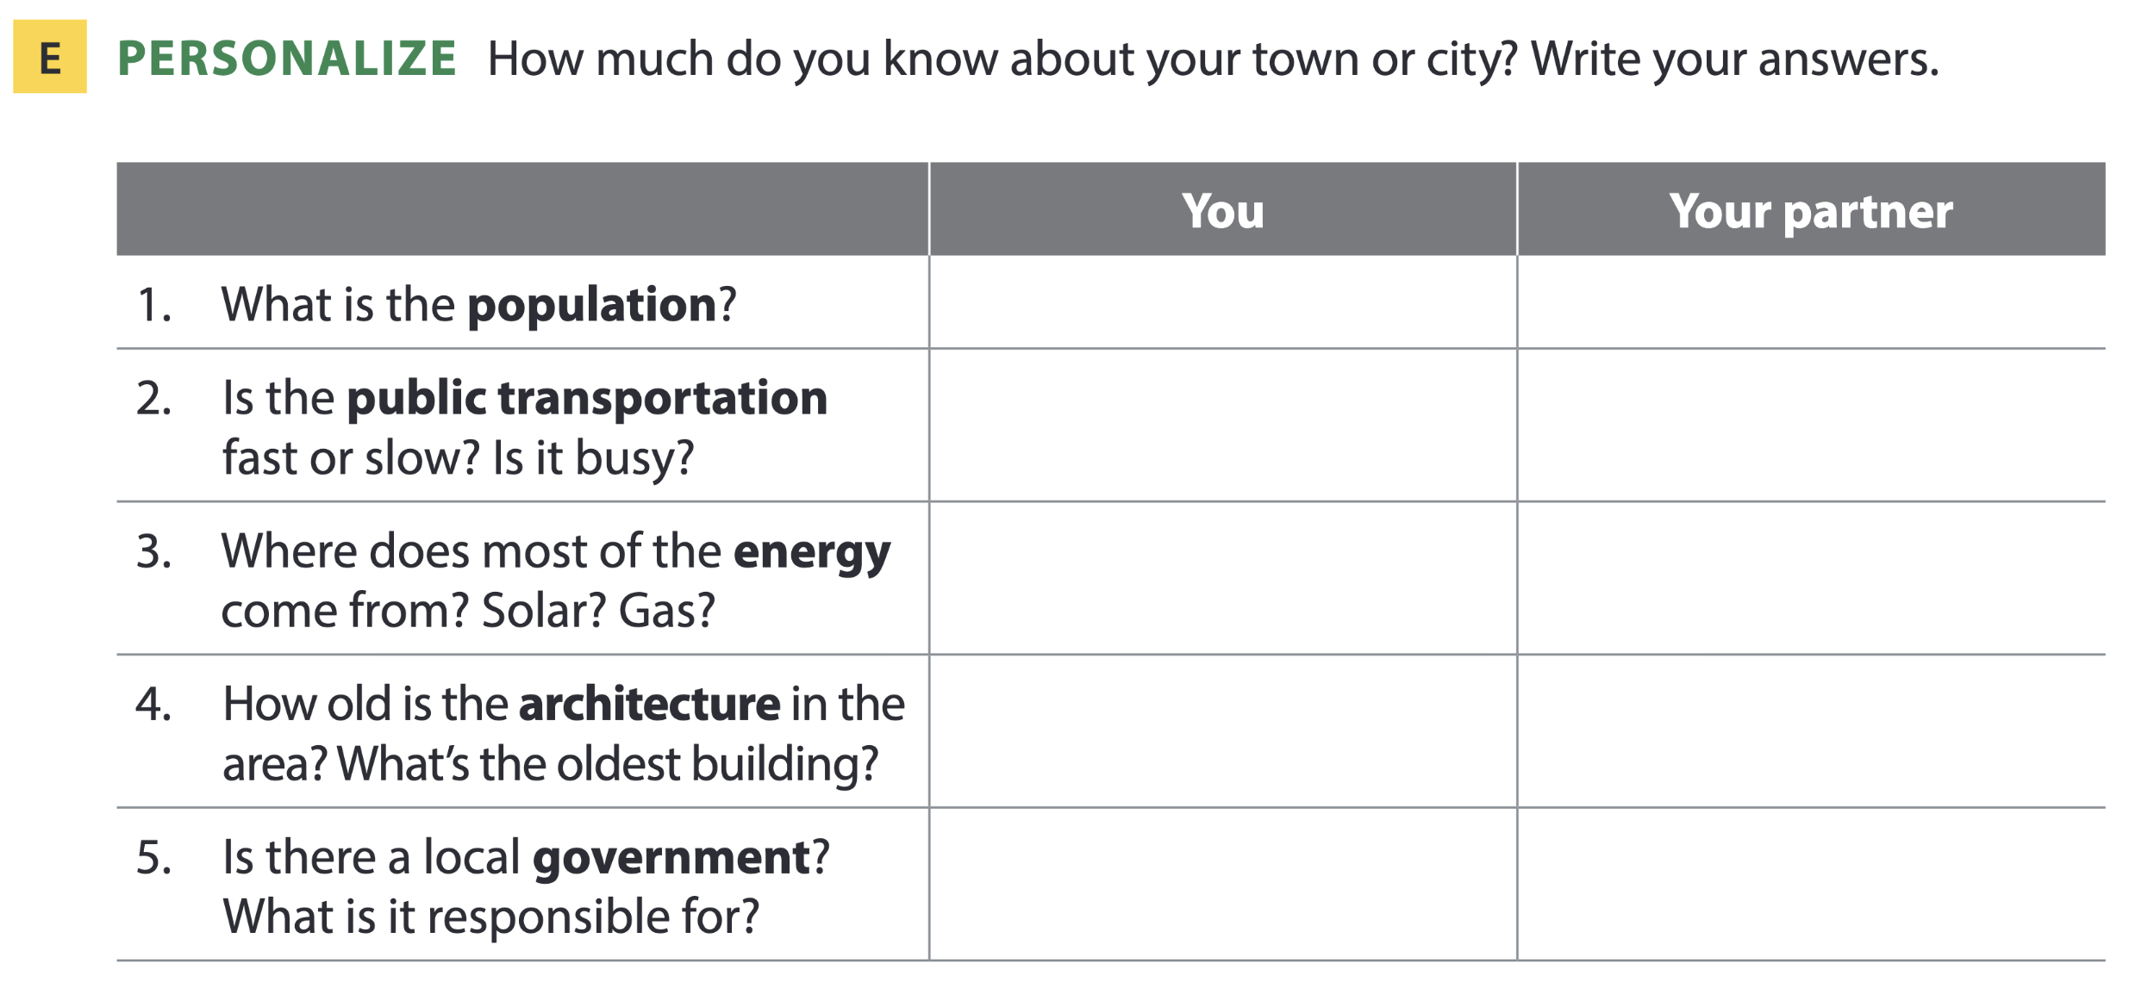
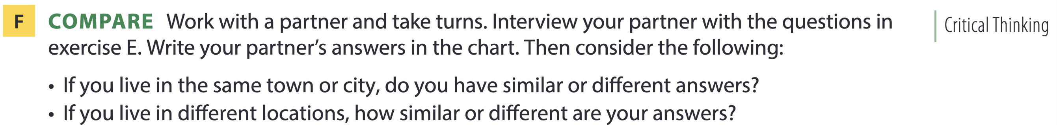
Page 113

Slide 32
05
Listening B

Slide 33
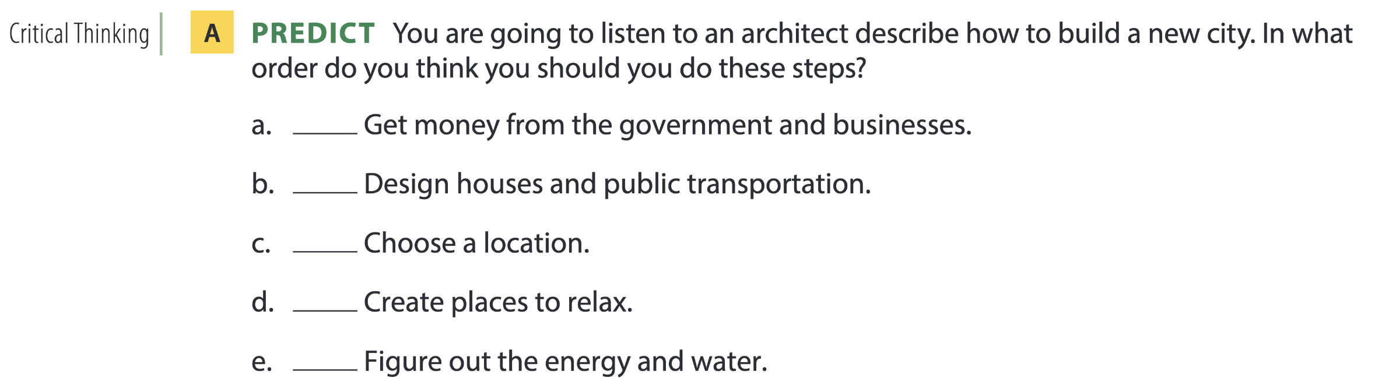
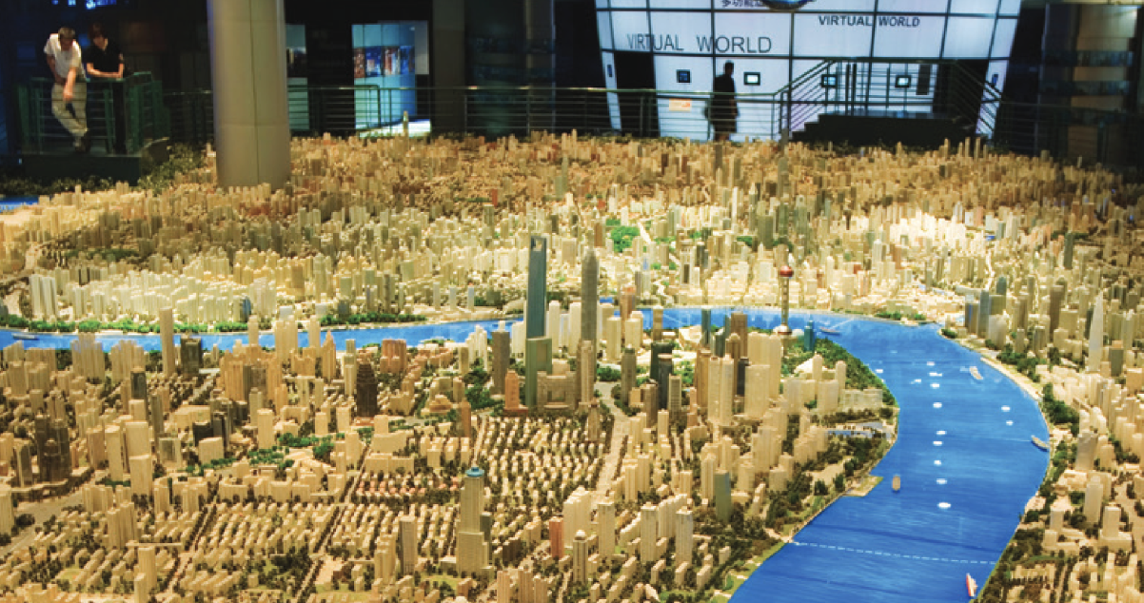
How to build a new city

Slide 34
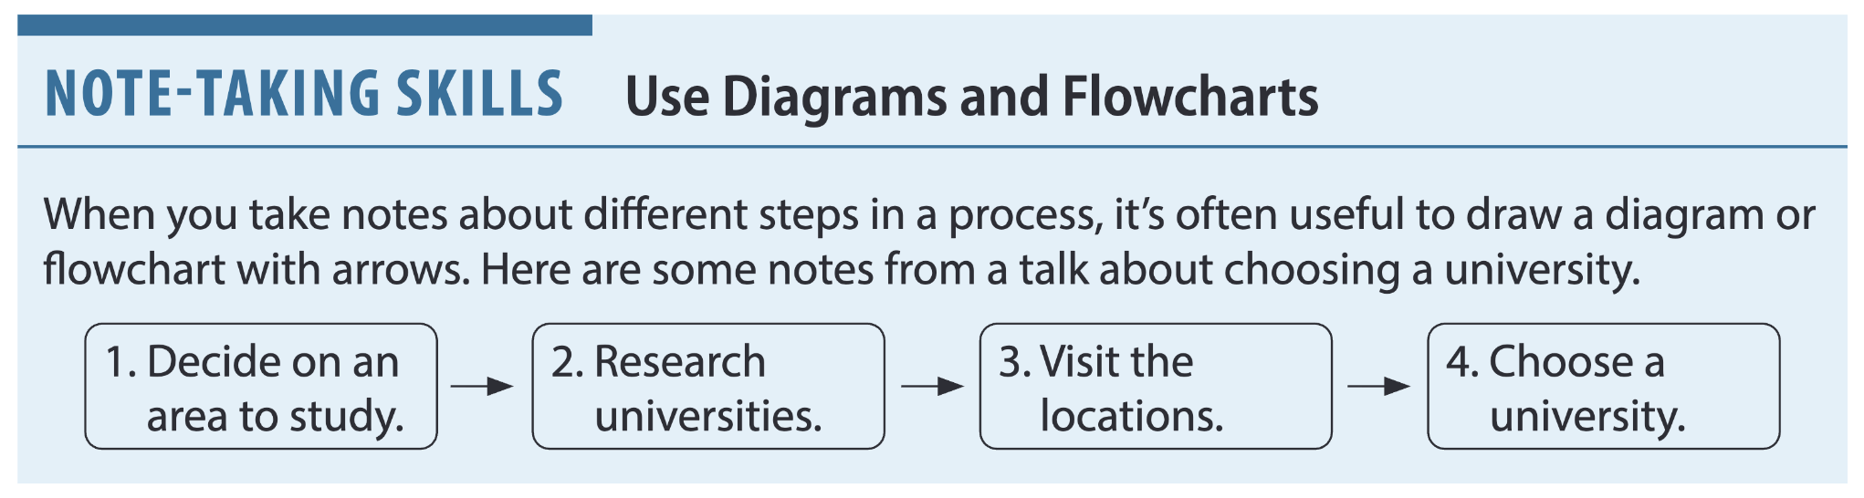
Page 114

Slide 35
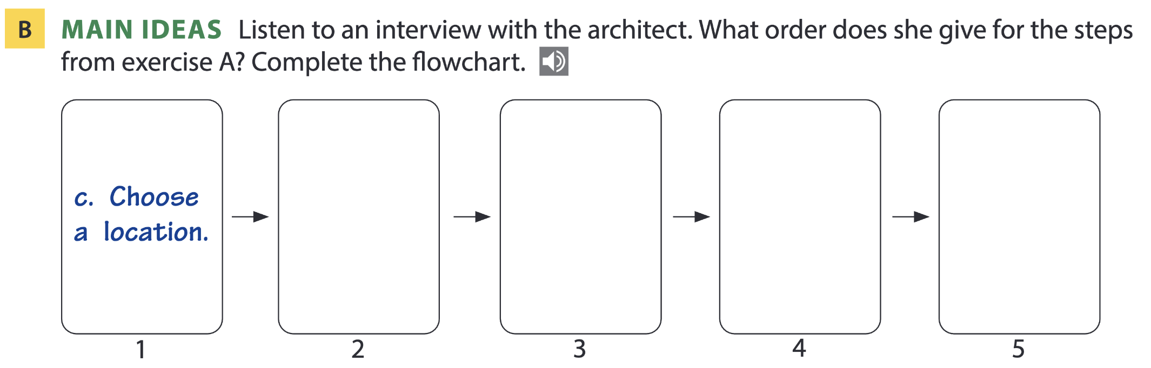
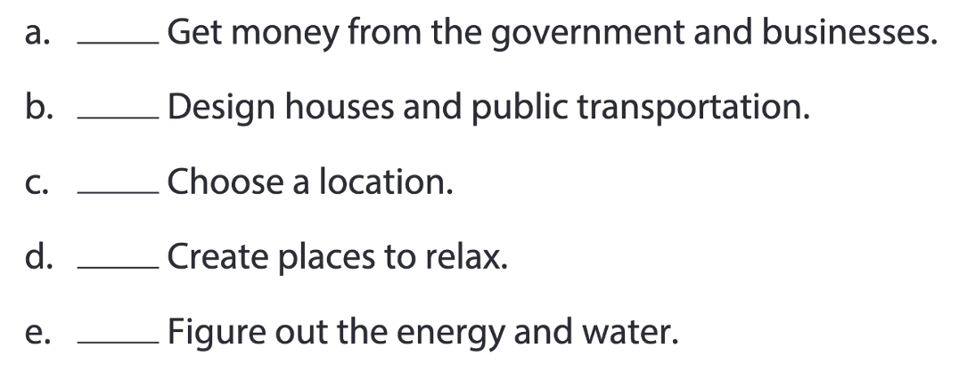
Page 114
e
a
b
d

Slide 36
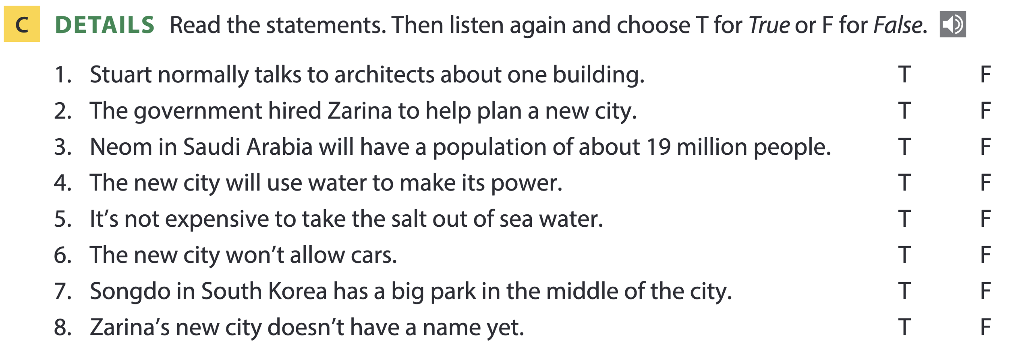
Page 114

Slide 37
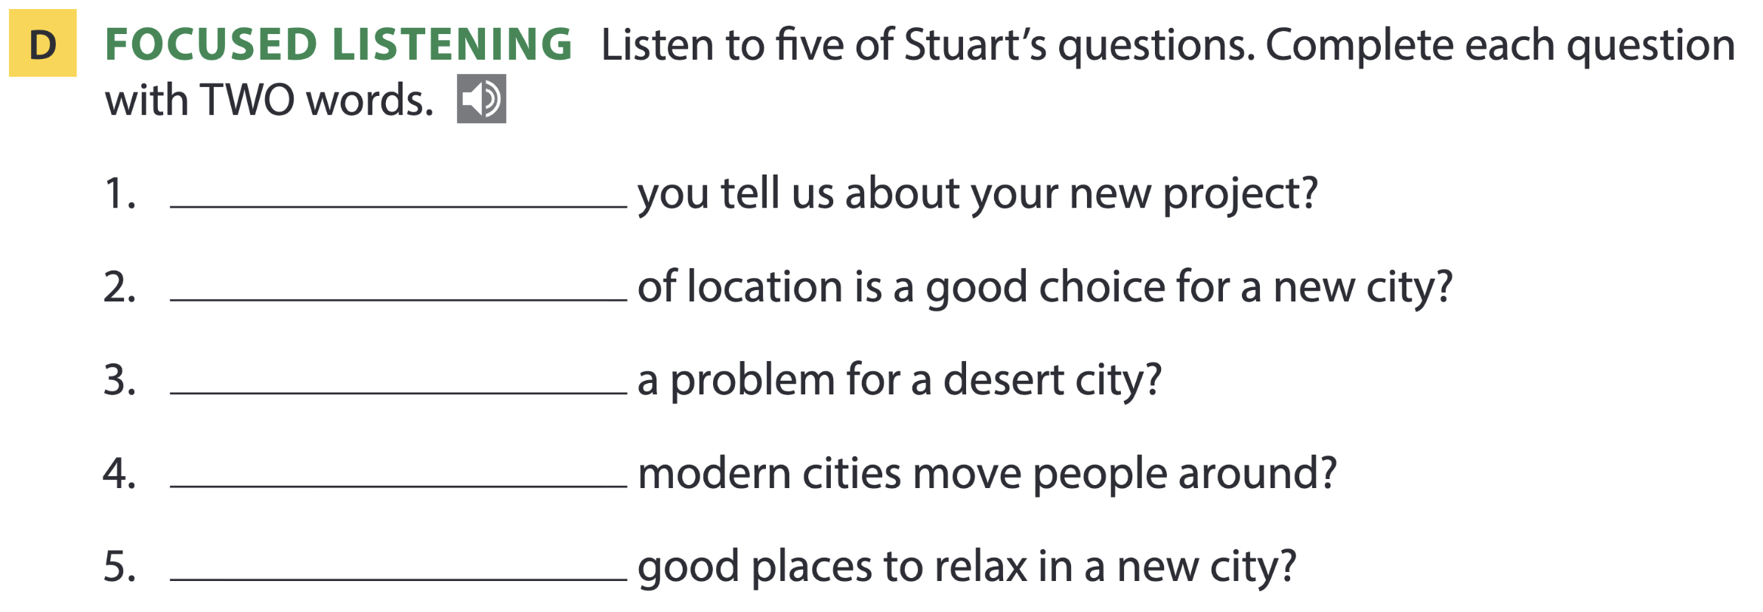
Page 115
What can
What kind
Isn’t water
How do
Where are

Slide 38
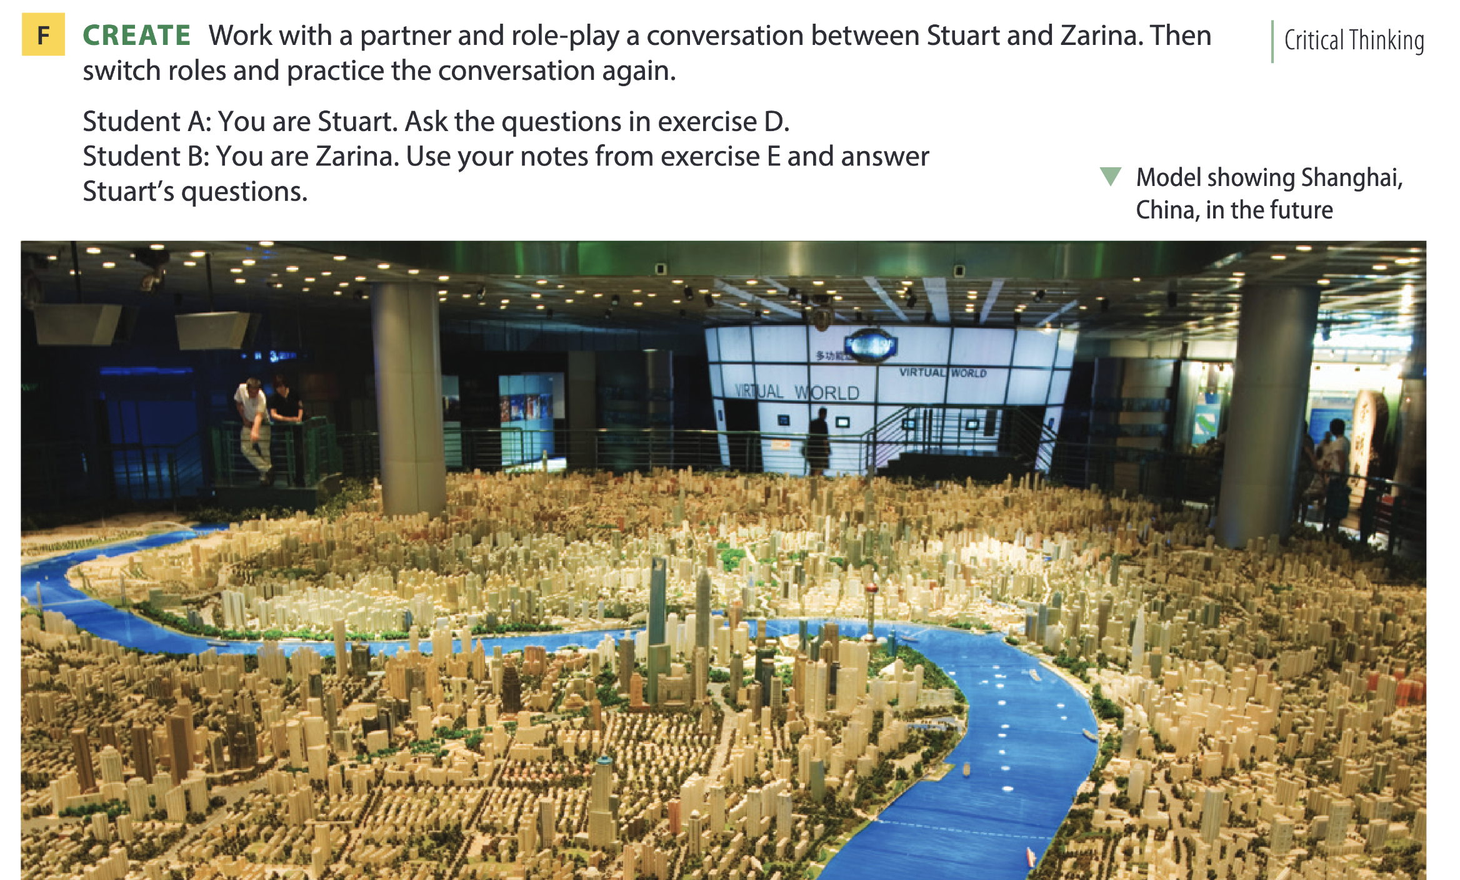
Page 115

Slide 39
THANKS FOR YOUR ATTENTION!

